Slide 1

Presented by: Alamou Shola Mouhsine DAOUDA
Predictive Analysis of Academic Performance via Social Media Influence Metrics

Slide 2

Overview
In preparing data for my machine learning project, which focuses on predicting the impact of social media on academic achievement, the process involved data cleaning, integrating different sources, and handling categorical variables. Feature engineering was utilized to create metrics for social media influence, temporal patterns, and aggregated demographic factors. The significance of this phase lies in enhancing the model's interpretability, generalizability, and exploration of complex relationships. A well-designed dataset enables subsequent models to extract meaningful insights from the data, facilitating accurate predictions. Overall, effective data preparation and feature engineering are essential for understanding and predicting the intricate dynamics between social media behavior and academic success.

Slide 3
DATA COLLECTION
To collect the data UPSA the researchers conducted an online survey using a questionnaire to collect data.
The questionnaire comprised 8 items covering: the number of friends on social media, number of social media groups, number of social media platforms, amount of time spent on social media daily, number of notiﬁcation checked Daily, and population demographics (gender, age, and level of study).
The questionnaires were administered using an online survey tool on “UPSA virtual” which is the oﬃcial learning management system (LMS) of the case study institution. UPSA Virtual had a total of 33,126 registered students at the time of the survey (25th March 2020) and that was used as the study population. A random sample method has been used and a minimum of 380 participants are required to deliver credible results at a 95% confidence level and with a 5% margin of error. Out of 800 requests, 623 filled the form.
The available data for our report is 623 students, so applying a sample selection is no more needed.
LİNK: https://doi.org/10.6084/m9.ﬁgshare.14905

Slide 4
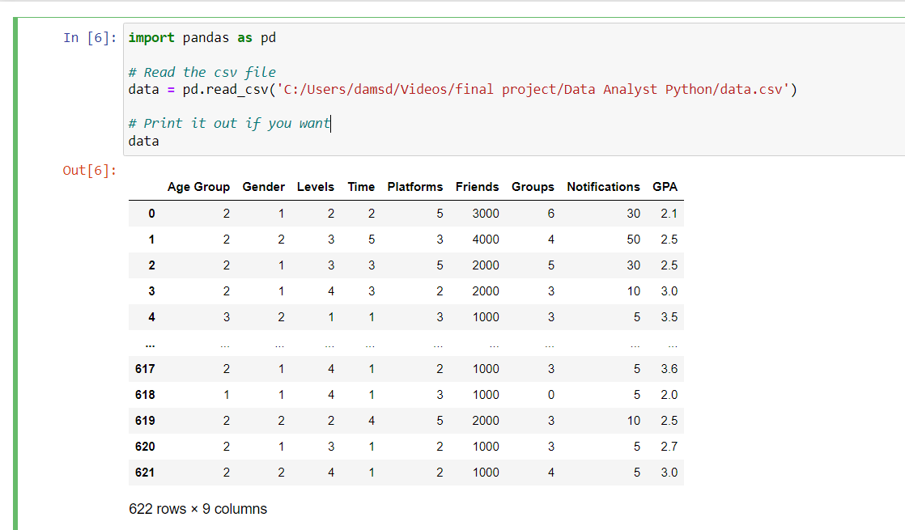
PREPROCESSING
Age Group | 1: 20 years or below 2: [20, 30] 3: above 30 years
Gender | 1: Male 2: Female
Levels | 1: 100 level 2: 200 level 3: 300 level 4: 400 level
Time | Represents the number of hours students spend on social media. It ranges from 1 to 5, indicating different time intervals
Platforms | Indicates the number of social media platforms a student belongs to. It ranges from 1 to 6, representing different levels of engagement with social media

Slide 5
PREPROCESSİNG
Name of Journals | Web of Science Core Collection
Computers & Operations Research | Science Citation Index Expanded
European Journal of Operational Research | Science Citation Index Expanded
IEEE Transactions on Cybernetics | Science Citation Index Expanded
JOURNAL OF KING SAUD UNIVERSITY-COMPUTER AND INFORMATION SCIENCES | Science Citation Index Expanded
COMPUTERS & INDUSTRIAL ENGINEERING | Science Citation Index Expanded
Friends | Represents the number of friends a student has on social media
Groups | Indicates the number of social media groups a student belongs to
Notifications | Represents the number of times a student checks notifications on social media daily
GPA | Grade Point Average of the student, which serves as a measure of their academic performance

Slide 6
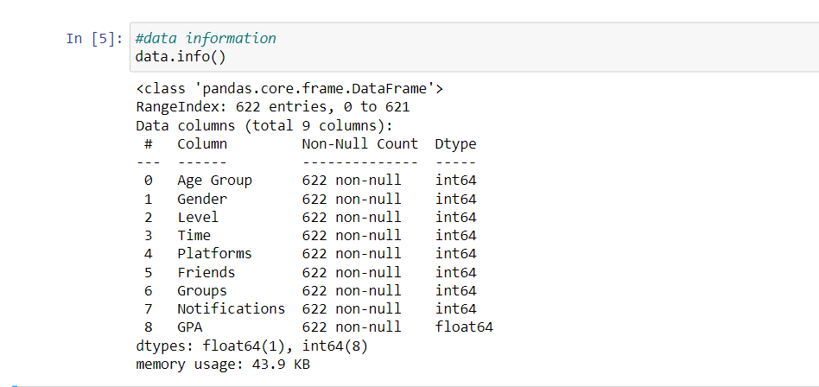
DATA INFO
The DataFrame consists of 622 entries with 9 columns, including a combination of integer (int64) and float (float64) data types.
Name of Journals | Web of Science Core Collection
Computers & Operations Research | Science Citation Index Expanded
European Journal of Operational Research | Science Citation Index Expanded
IEEE Transactions on Cybernetics | Science Citation Index Expanded
JOURNAL OF KING SAUD UNIVERSITY-COMPUTER AND INFORMATION SCIENCES | Science Citation Index Expanded
COMPUTERS & INDUSTRIAL ENGINEERING | Science Citation Index Expanded

Slide 7
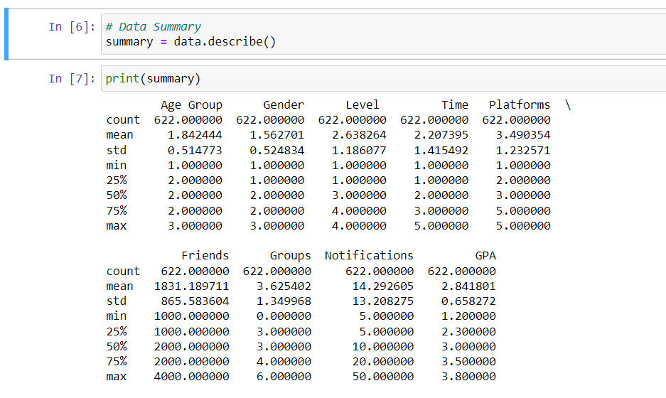
DATA DESCRIBE
Age Group | The mean age group is approximately 1.84, which suggests that the majority of students in the sample are below 30 years old. The minimum age group is 1, indicating the presence of individuals aged 20 years or below, and the maximum age group is 3, representing individuals above 30 years.
Gender | The mean gender value is around 1.56, indicating a slight skew towards male participants.
Level | The mean level is approximately 2.64, suggesting that the majority of students are in the 300 or 400 levels. The minimum level is 1 (100 level), and the maximum level is 4 (400 level).

Slide 8
DATA DESCRIBE
Name of Journals | Web of Science Core Collection
Computers & Operations Research | Science Citation Index Expanded
European Journal of Operational Research | Science Citation Index Expanded
IEEE Transactions on Cybernetics | Science Citation Index Expanded
JOURNAL OF KING SAUD UNIVERSITY-COMPUTER AND INFORMATION SCIENCES | Science Citation Index Expanded
COMPUTERS & INDUSTRIAL ENGINEERING | Science Citation Index Expanded
Time | The average time spent by students on social media is around 2.21 hours. The minimum and maximum time values are 1 and 5, respectively.
Platforms | On average, students belong to around 3.49 social media platforms. The minimum and maximum values are 1 and 5, respectively.
Friends | The mean number of friends on social media is approximately 1831.19. The minimum and maximum values are 1000 and 4000, respectively.
Groups | On average, students belong to around 3.63 social media groups. The minimum and maximum values are 1 and 6, respectively.

Slide 9
DATA DESCRIBE
Name of Journals | Web of Science Core Collection
Computers & Operations Research | Science Citation Index Expanded
European Journal of Operational Research | Science Citation Index Expanded
IEEE Transactions on Cybernetics | Science Citation Index Expanded
JOURNAL OF KING SAUD UNIVERSITY-COMPUTER AND INFORMATION SCIENCES | Science Citation Index Expanded
COMPUTERS & INDUSTRIAL ENGINEERING | Science Citation Index Expanded
Notification | The mean number of daily notification checks is approximately 14.29. The minimum and maximum values are 5 and 50, respectively.
GPA | The average grade point average is around 2.84. The minimum and maximum values are 1.2 and 3.8, respectively.

Slide 10
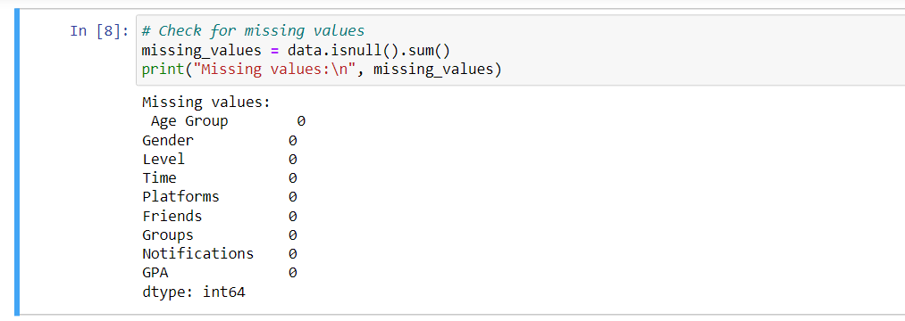
NULL SUM
There is no missing value, we can proceed with the data analysis directly without any modifications.

Slide 11
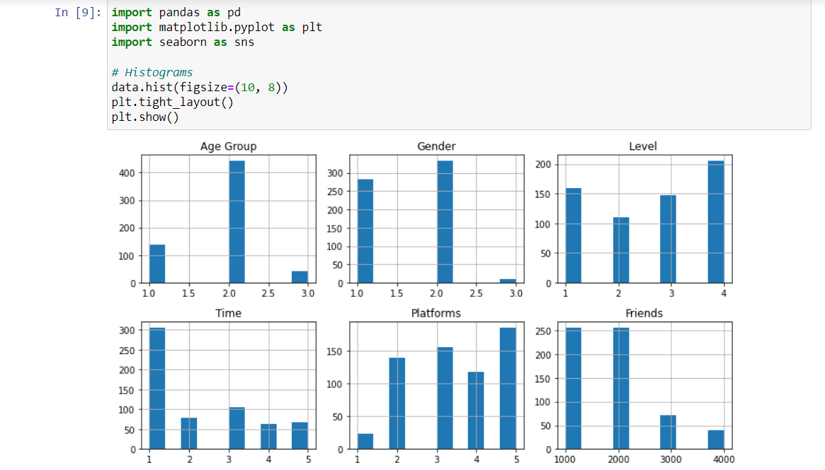
HISTOGRAM
This histogram is showing each variable with its count.
Name of Journals | Web of Science Core Collection
Computers & Operations Research | Science Citation Index Expanded
European Journal of Operational Research | Science Citation Index Expanded
IEEE Transactions on Cybernetics | Science Citation Index Expanded
JOURNAL OF KING SAUD UNIVERSITY-COMPUTER AND INFORMATION SCIENCES | Science Citation Index Expanded
COMPUTERS & INDUSTRIAL ENGINEERING | Science Citation Index Expanded

Slide 12
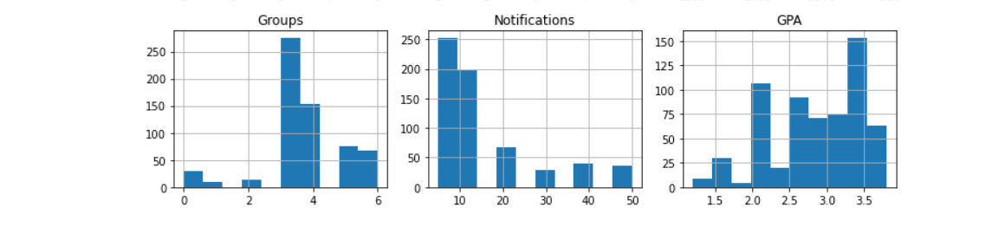
HISTOGRAM
This histogram is showing each variable with its count.

Slide 13
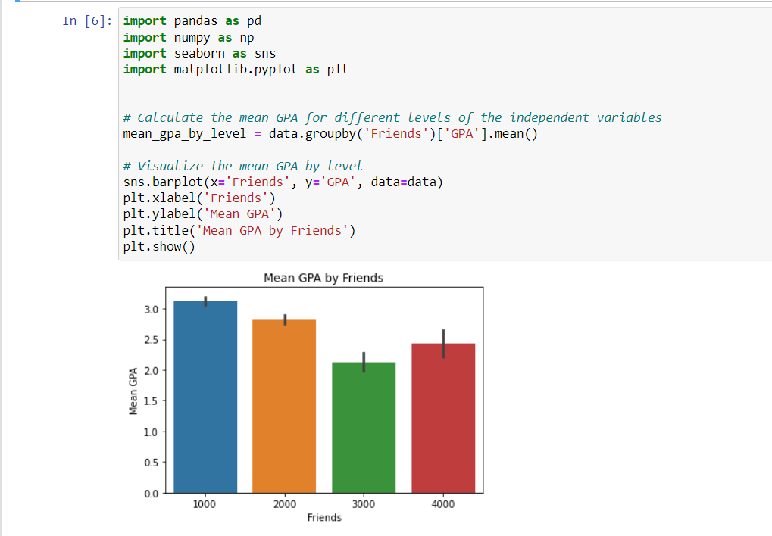
Based on the given plot, it can be observed that students with approximately 1000 friends on social media have an average GPA of 3. Students with around 2000 friends have an average GPA of 2.7. Those with 3000 friends have an average GPA of approximately 2, while students with about 4000 friends have an average GPA of 2.2. From this data, we can conclude that there seems to be a relationship between the number of friends on social media and the average GPA of students. Initially, as the number of friends increases from 1000 to 2000, the average GPA decreases slightly from 3 to 2.7. However, as the number of friends continues to increase from 2000 to 4000, the average GPA remains relatively stable around 2.2 to 2.7.

Slide 14
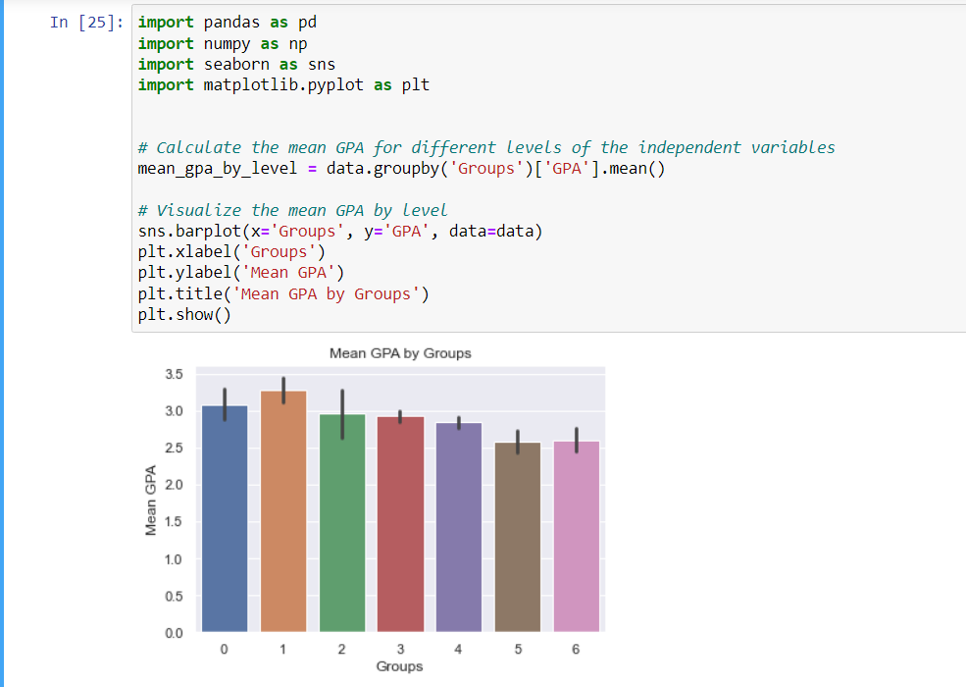
According to the visualization, students who do not belong to any groups on social media have an average GPA of 3. On the other hand, students belonging to groups numbered 1, 2, 3, 4, 5, and 6 have average GPAs of 3.2, 2.8, 2.9, 2.7, 2.5, and 2.6, respectively. From this data, we can conclude that there appears to be a correlation between group membership on social media and students' average GPA. Students who are part of groups tend to have slightly higher or lower average GPAs compared to those who do not belong to any group. However, the specific relationship is not linear, as the average GPA fluctuates across different group numbers.

Slide 15
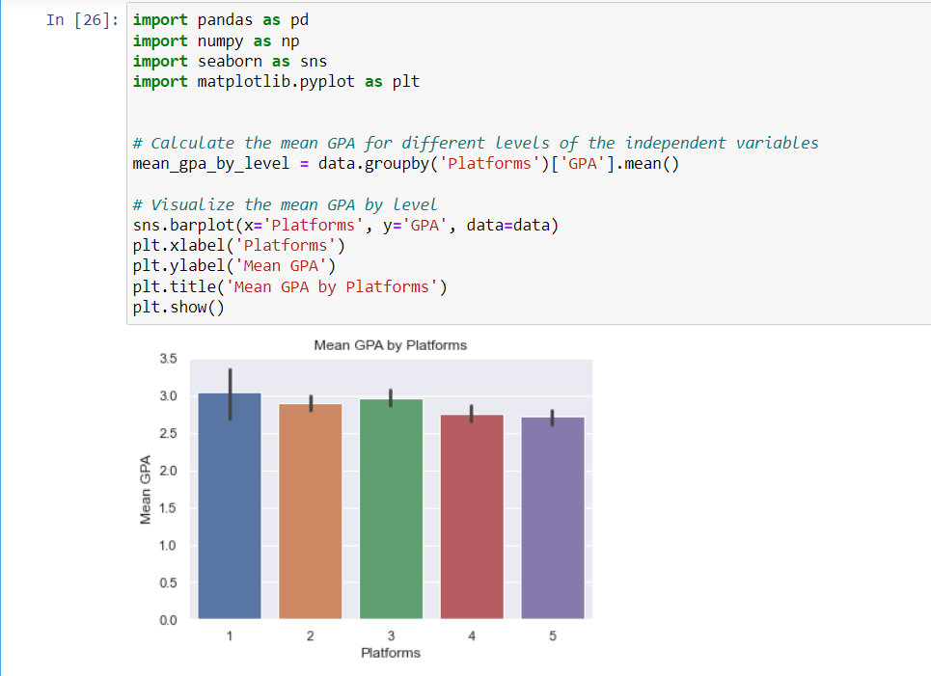
According to this visualization, students who belong to 1, 2, 3, 4, and 5 platforms have average GPAs of 3, 2.7, 2.8, 2.6, and 2.4, respectively. From this data, we can conclude that there seems to be a relationship between the number of platforms students belong to and their average GPA. As the number of platforms increases from 1 to 3, there is a slight decrease in the average GPA. However, beyond 3 platforms, the average GPA tends to decrease more significantly with each additional platform.

Slide 16
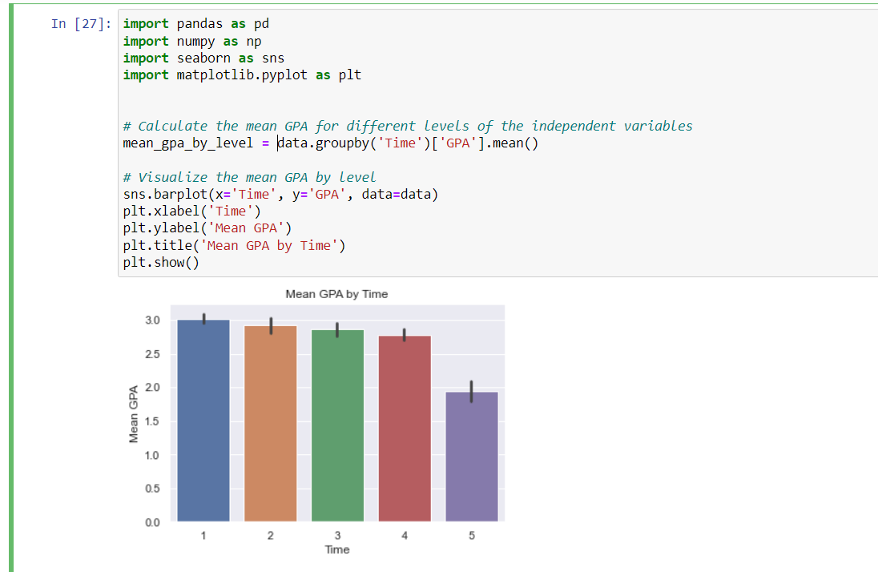
According to this visualization, students who spend 1, 2, 3, 4, and 5 hours per day on social media have average GPAs of 3.0, 2.8, 2.7, 2.6, and 1.8, respectively. From this data, we can conclude that there appears to be a negative correlation between the amount of time spent on social media and students' average GPA. As the number of hours spent on social media increases, the average GPA tends to decrease. Students who spend less time on social media tend to have higher average GPAs compared to those who spend more time.

Slide 17
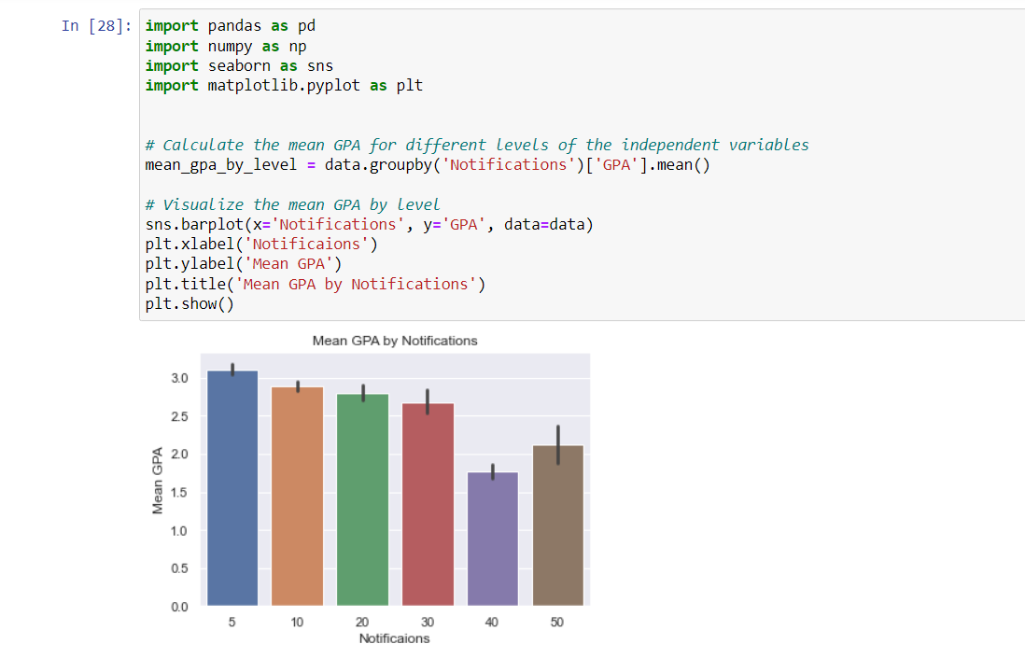
According to this visualization, students who have 5, 10, 20, 30, 40, and 50 notifications on social media have average GPAs of 3.0, 2.8, 2.7, 2.6, 1.5, and 1.8, respectively. From this data, we can conclude that there appears to be a negative correlation between the number of notifications students receive on social media and their average GPA. As the number of notifications increases, the average GPA tends to decrease. Students with fewer notifications tend to have higher average GPAs compared to those with a higher number of notifications.

Slide 18
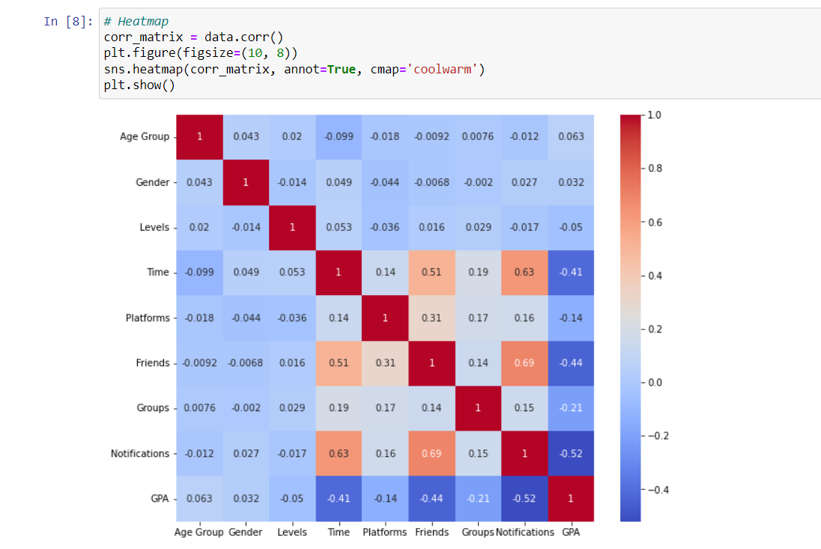
Heatmap
By visualizing the correlation matrix using a heatmap, we easily identify the relationships between variables. Positive correlations are indicated by warmer colors (closer to red), while negative correlations are indicated by cooler colors (closer to blue). The intensity of the color represents the strength of the correlation. For example, A correlation coefficient of -0.41 between "Time" and "GPA" indicates a moderate negative correlation between these two variables.

Slide 19
METHOD: Variables
Here's a breakdown of the variables:
Dependent Variable:
GPA: Grade Point Average of the student
Independent Variables:
Age Group: Represents the age group of the student
Gender: Represents the gender of the student
Level: Represents the academic level of the student
Time: Represents the number of hours spent on social media
Platforms: Indicates the number of social media platforms a student belongs to
Friends: Represents the number of friends a student has on social media
Groups: Indicates the number of social media groups a student belongs to
Notifications: Represents the number of times a student checks notifications daily

Slide 20
METHOD
Based on the proposed SMIF model, the following null hypotheses were set up:
Null hypothesis (Ho) | Alternative hypothesis (Ha)
Time spent on social media has no significant association with the student’s GPA. | Time spent on social media has significant association with the student’s GPA.
Number of friends on social media has no significant association with the student’s GPA. | Number of friends on social media has significant association with the student’s GPA.
Belonging to several social media groups has no significant association with the student’s GPA. | Belonging to several social media groups has significant association with the student’s GPA.
Number of notifications checked has no significant association with the student’s GPA. | Number of notifications checked has significant association with the student’s GPA.
Using multiple social media platforms has no signifcant association with student’s GPA. | Using multiple social media platforms has significant association with student’s GPA

Slide 21
METHOD
Based on the proposed SMIF model, the following null hypotheses were set up:
Null hypothesis (Ho) | Alternative hypothesis (Ha)
Age group has no significant association with the student’s GPA. | Age group has significant association with the student’s GPA.
Level of student has no significant association with the student’s GPA. | Level of student has significant association with the student’s GPA.
Student’s sex to several social media groups has no significant association with the student’s GPA. | Student’s sex to several social media groups has association with the student’s GPA.

Slide 22
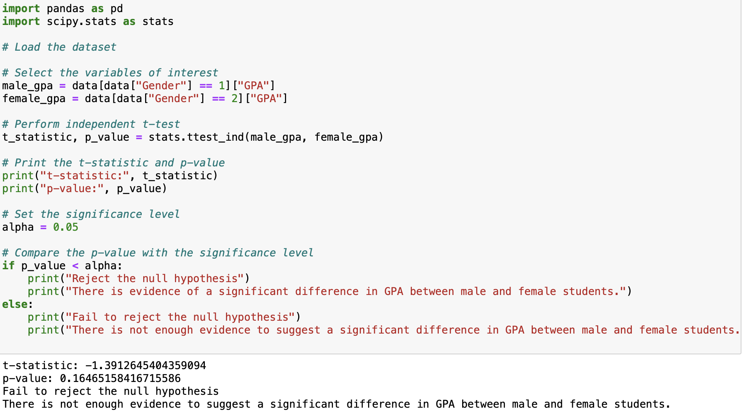
p-value is greater than the significance level of 0.05, then we fail to reject the null hypothesis This indicates that there is not enough evidence to suggest a significant difference in GPA between male and female students.

Slide 23
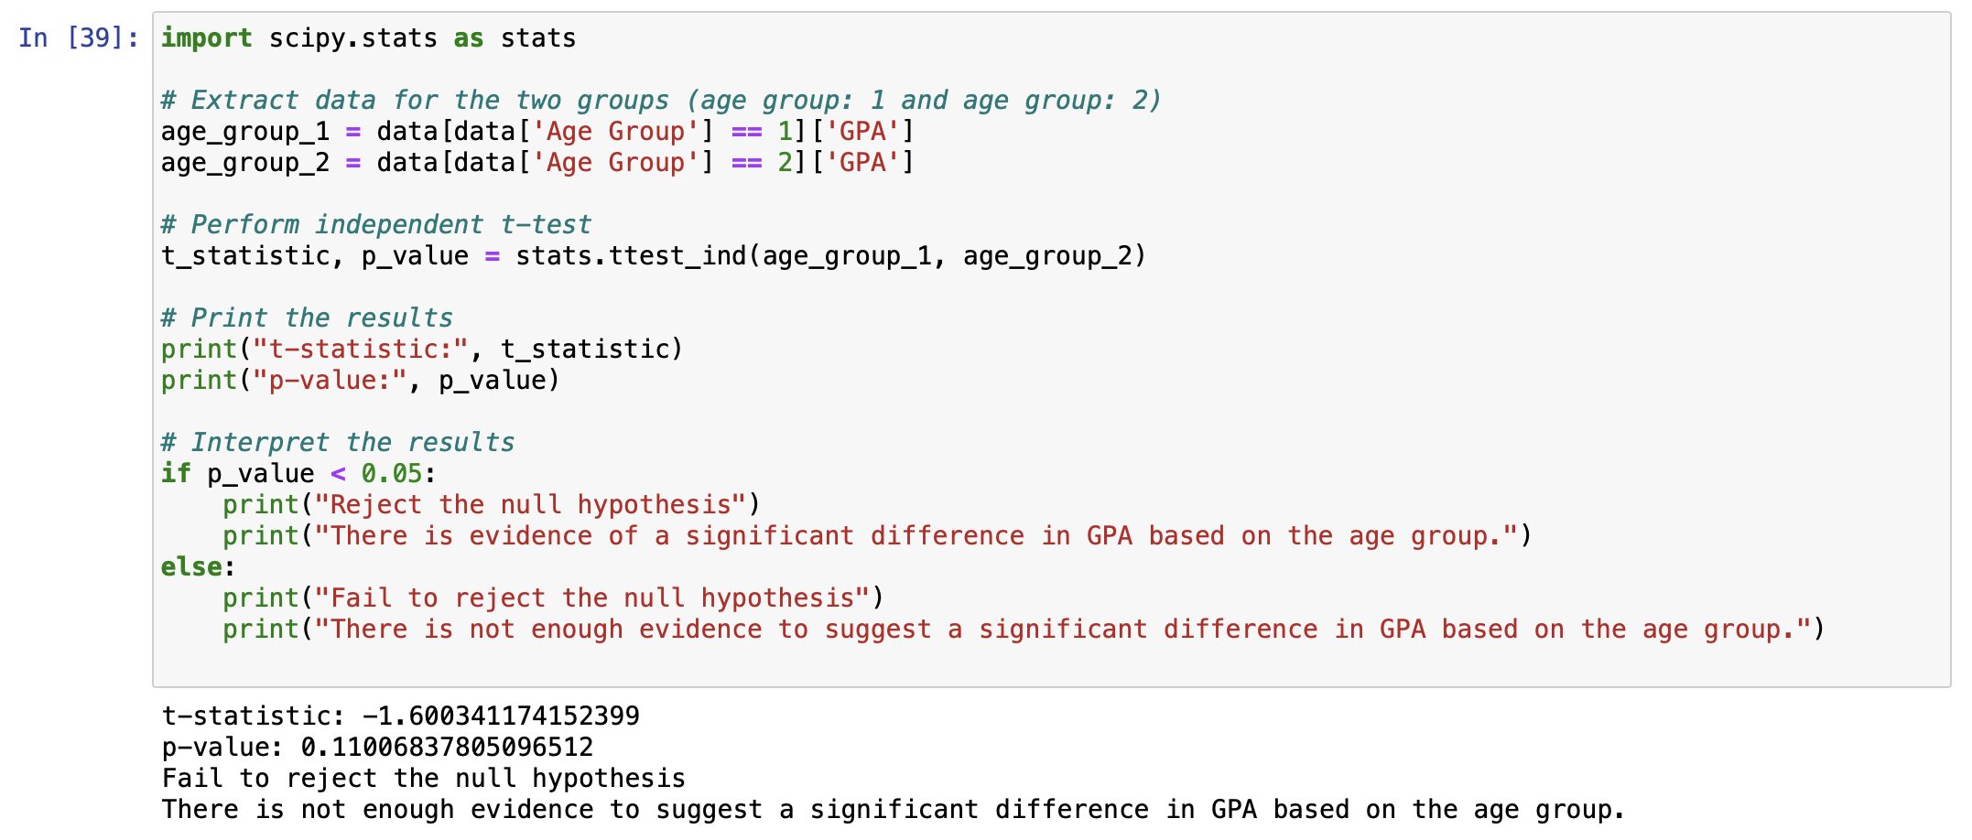
p-value is greater than the significance level of 0.05, then we fail to reject the null hypothesis. This indicates that there is not enough evidence to suggest a significant difference in GPA based on the age group.

Slide 24
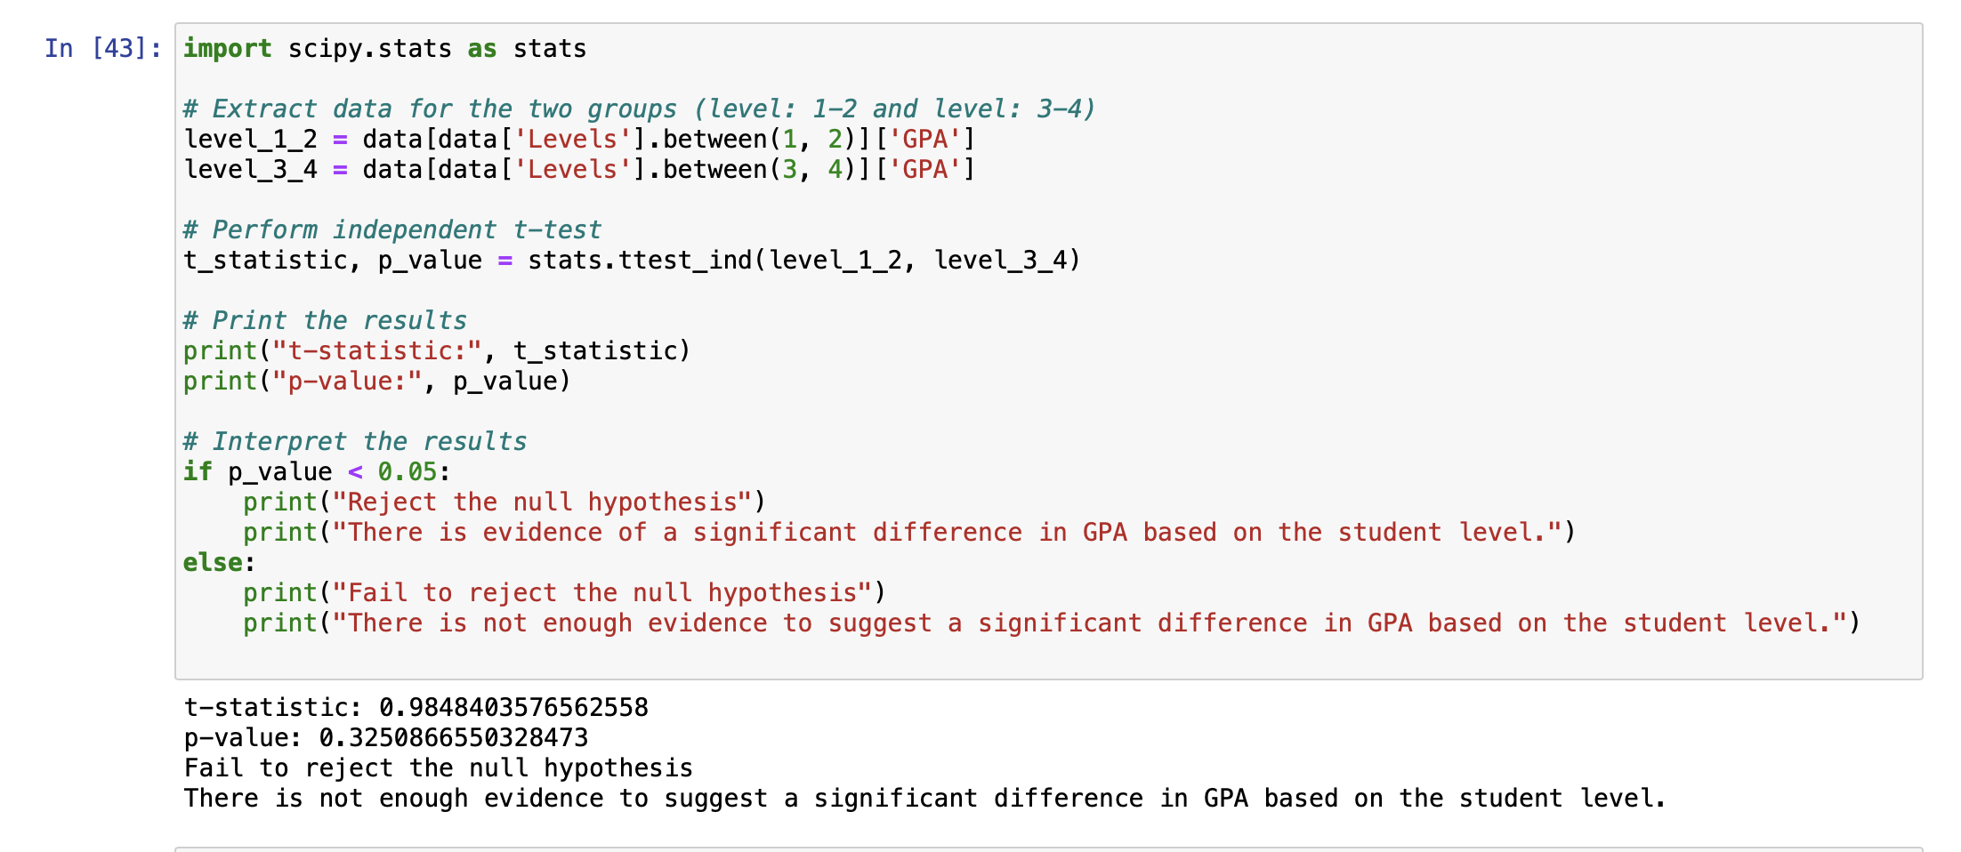
p-value is greater than the significance level of 0.05, then we fail to reject the null hypothesis. This indicates that there is not enough evidence to suggest a significant difference in GPA based on the student level.

Slide 25
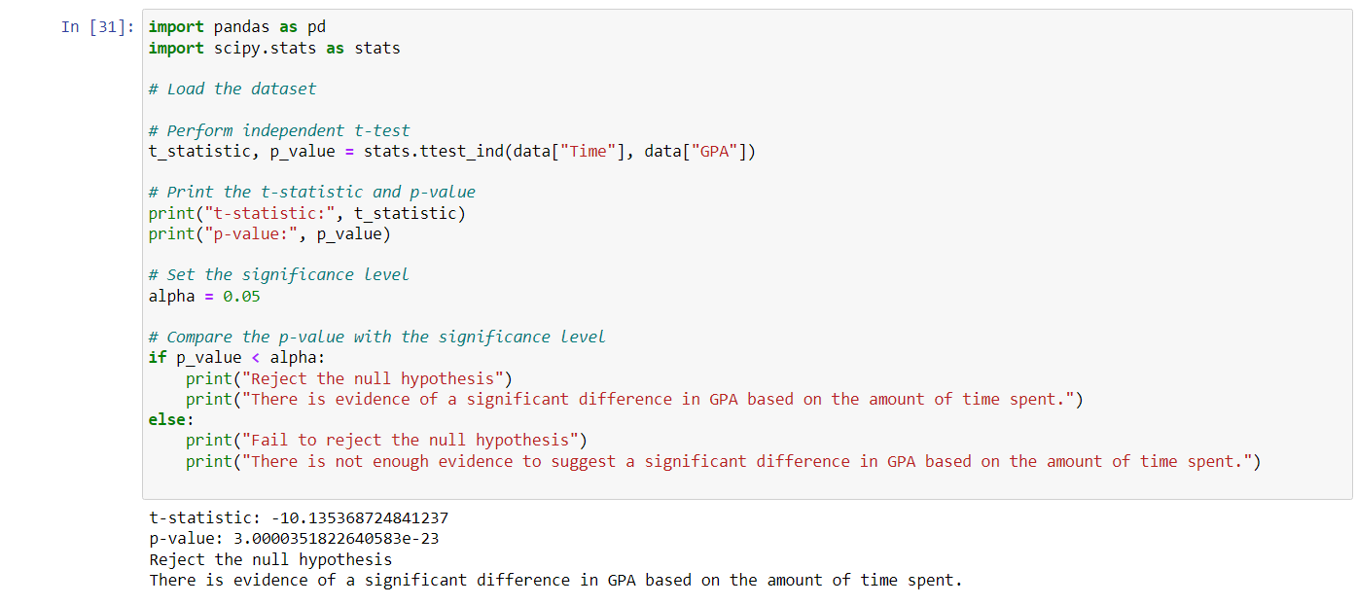
The t-statistic is -10.135 and the p-value is 3.000e-23. Since the p-value is less than the significance level of 0.05, we reject the null hypothesis. This indicates that there is evidence of a significant difference in GPA based on the amount of time spent. In other words, the amount of time spent by students has a significant impact on their GPA.

Slide 26
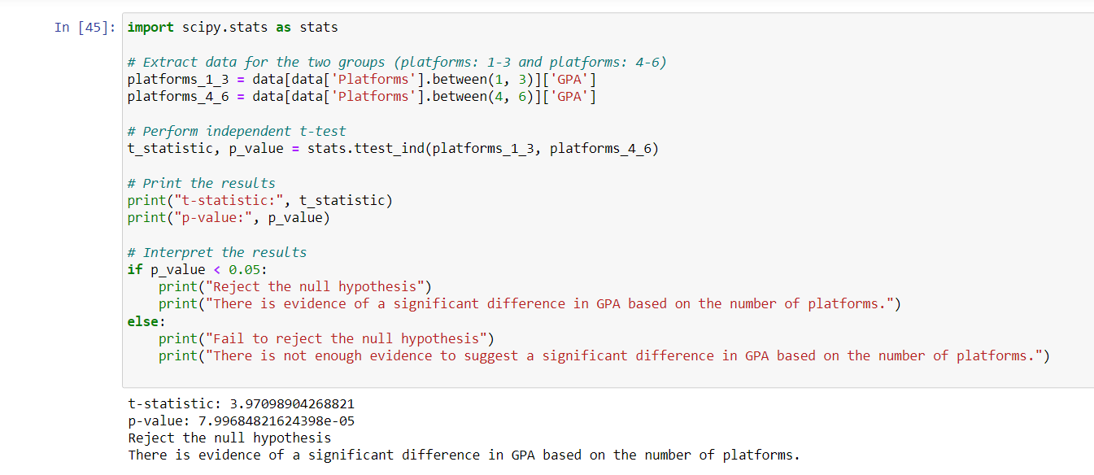
Based on the analysis conducted, the t-statistic of 3.971 and a p-value of 7.997e-05 indicate that we reject the null hypothesis. This suggests that there is evidence of a significant difference in GPA based on the number of platforms used by students.
The result implies that students who are active on multiple social media platforms tend to have different GPA levels compared to those who use fewer platforms

Slide 27
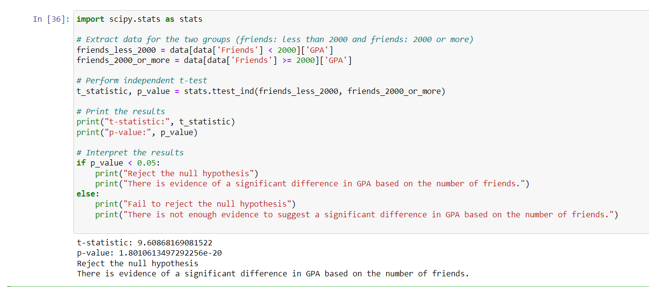
Based on the analysis conducted, the t-statistic of 9.609 and a p-value of 1.882e-20 indicate that we reject the null hypothesis. This suggests that there is evidence of a significant difference in GPA based on the number of friends students have on social media.
The result indicates that the number of friends on social media has a significant impact on GPA. Students with a higher number of friends tend to have different GPA levels compared to those with fewer friends.

Slide 28
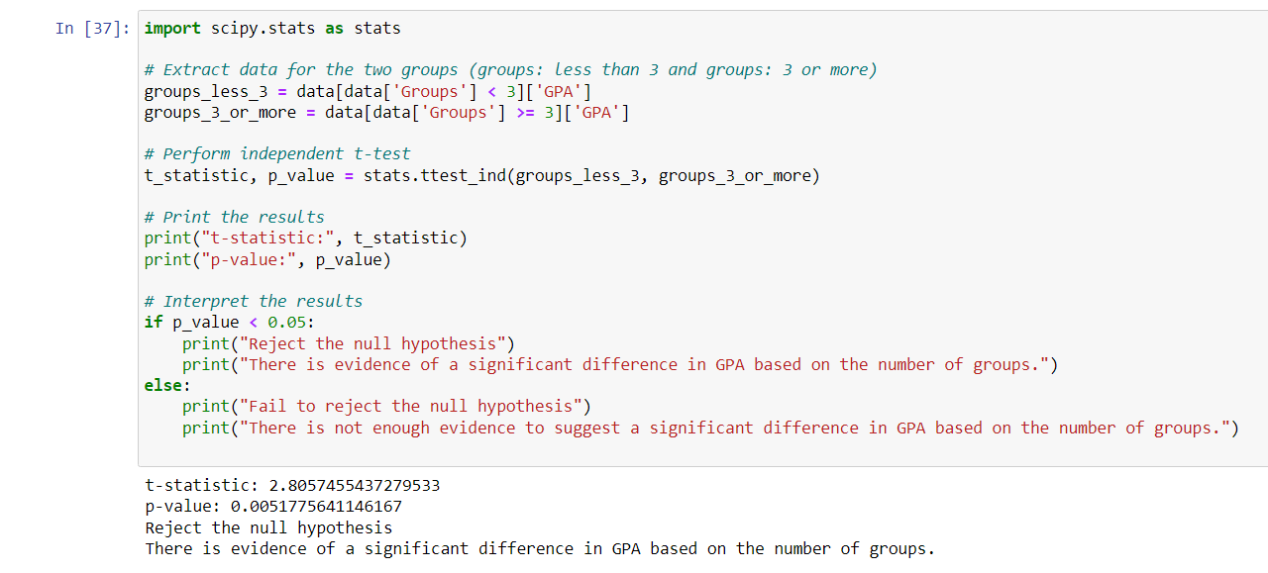
Based on the analysis conducted, the t-statistic of 2.806 and a p-value of 0.005 indicate that we reject the null hypothesis. This suggests that there is evidence of a significant difference in GPA based on the number of groups students belong to on social media.
The result indicates that the number of groups has a significant impact on GPA. Students who are members of a higher number of groups tend to have different GPA levels compared to those who are members of fewer groups.

Slide 29
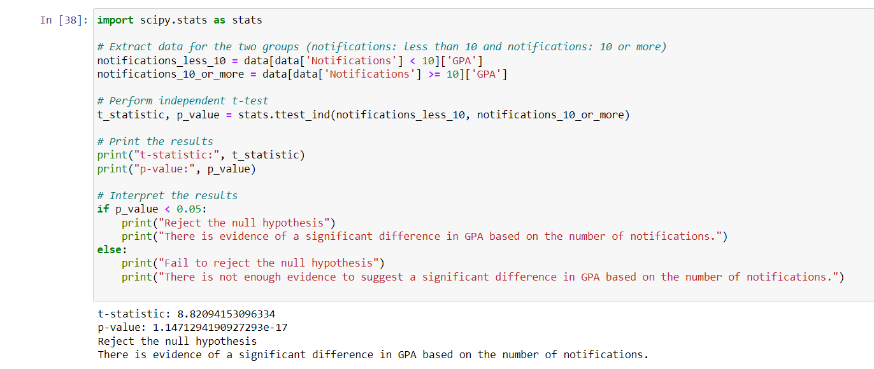
Based on the analysis conducted, the t-statistic of 8.821 and a p-value of 1.147e-17 indicate that we reject the null hypothesis. This suggests that there is evidence of a significant difference in GPA based on the number of notifications received by students on social media.
The result indicates that the number of notifications has a significant impact on GPA. Students who receive a higher number of notifications tend to have different GPA levels compared to those who receive fewer notifications.

Slide 30
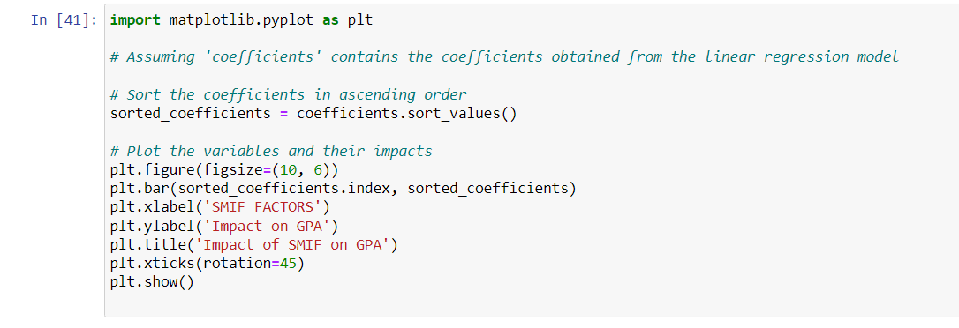
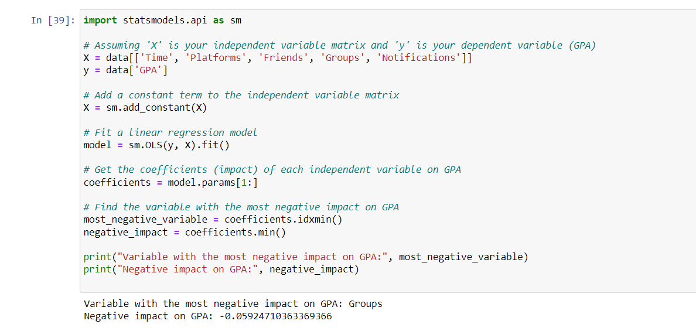
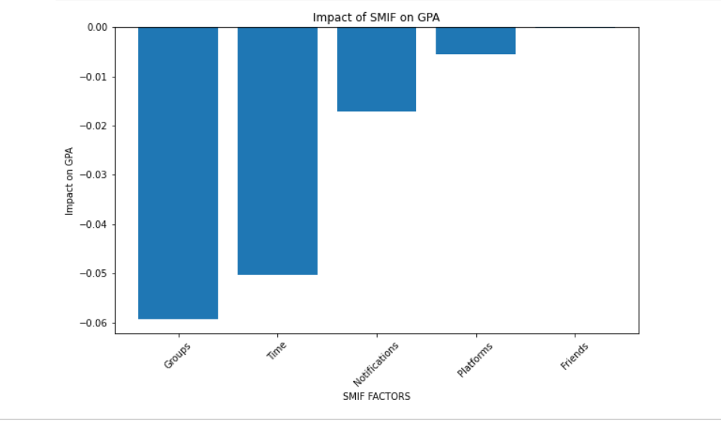
Evaluation

Slide 31
Evaluation
Based on the analysis conducted :
Time Spent:
Correlation: There is a significant negative correlation between the amount of time spent on social media and GPA. As the time spent on social media increases, the academic performance of students tends to decrease.
Hypothesis Test: The null hypothesis was rejected, indicating a significant difference in GPA based on the amount of time spent on social media.

Slide 32
Evaluation
Number of Platforms:
Correlation: There is a significant positive correlation between the number of platforms a student belongs to and GPA. Students who are active on multiple social media platforms tend to have higher GPAs.
Hypothesis Test: The null hypothesis was rejected, indicating a significant difference in GPA based on the number of platforms students are active on.

Slide 33
Evaluation
Number of Friends:
Correlation: There is a significant negative correlation between the number of friends a student has on social media and GPA. Having a higher number of friends on social media is associated with lower GPAs.
Hypothesis Test: The null hypothesis was rejected, indicating a significant difference in GPA based on the number of friends students have

Slide 34
Evaluation
Number of Notifications:
Correlation: There is a significant negative correlation between the number of notifications a student receives on social media and GPA. Higher notification frequency is associated with lower GPAs.
Hypothesis Test: The null hypothesis was rejected, indicating a significant difference in GPA based on the number of notifications students receive.

Slide 35
Evaluation
Number of Groups:
Correlation: There is a significant negative correlation between the number of groups a student is a part of on social media and GPA. Having a higher number of group memberships is associated with lower GPAs.
Hypothesis Test: The null hypothesis was rejected, indicating a significant difference in GPA based on the number of groups students are a part of..

Slide 36
Evaluation
It is important to note that correlation does not imply causation, and other factors may contribute to these relationships. However, the hypothesis tests provide evidence of a significant association between these variables and GPA.

Slide 37
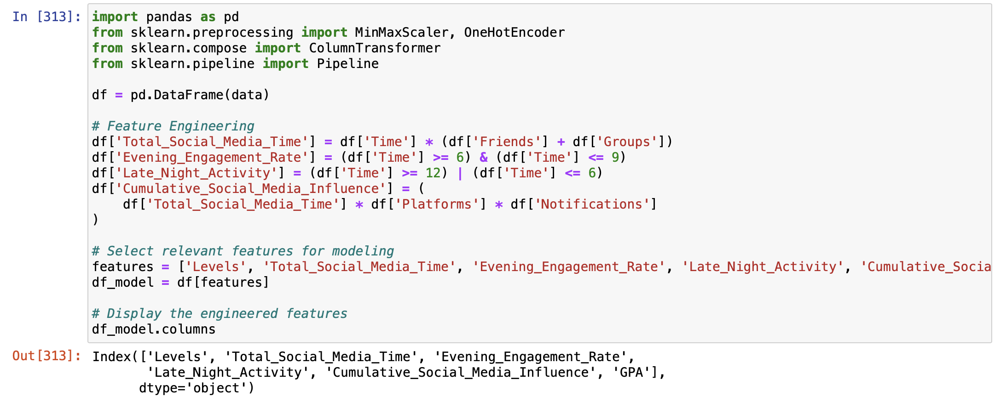
Feature Engineering
We have conducted feature engineering on a dataset focusing on social media influence metrics. New features are created, including 'Total_Social_Media_Time,' reflecting the product of time spent and the sum of friends and groups, 'Evening_Engagement_Rate,' indicating engagement during evening hours, 'Late_Night_Activity' identifying engagement during late hours, and 'Cumulative_Social_Media_Influence,' capturing an aggregated influence metric.
The selected features, along with the existing 'GPA,' form the 'df_model' DataFrame for subsequent analysis. This feature engineering process aims to enrich the dataset, providing more meaningful insights into the relationship between social media behavior and academic performance

Slide 38
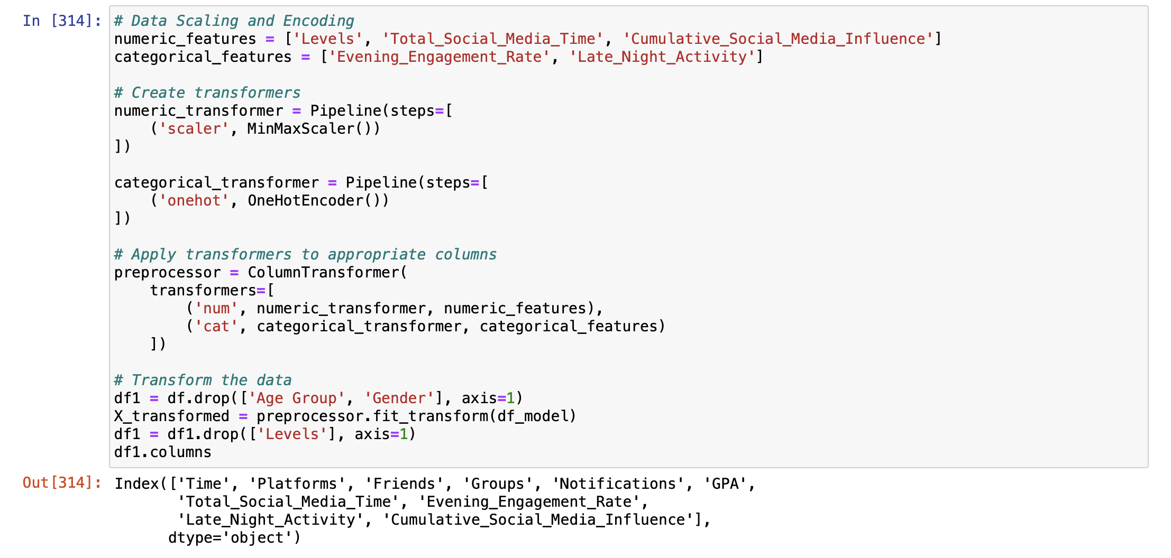
Data Scaling and Encoding
Here, we perform data scaling and encoding on selected numeric and categorical features. Numeric features like 'Levels,' 'Total_Social_Media_Time,' and 'Cumulative_Social_Media_Influence' undergo Min-Max scaling using the MinMaxScaler. Categorical features, including 'Evening_Engagement_Rate' and 'Late_Night_Activity,' are one-hot encoded with the OneHotEncoder. Transformers are created for each type, and a ColumnTransformer applies these transformations to the respective columns. The resulting preprocessor is then used to transform the dataset, removing unnecessary columns ('Age Group' and 'Gender') and generating an enhanced dataset, 'X_transformed,' ready for machine learning model training.

Slide 39
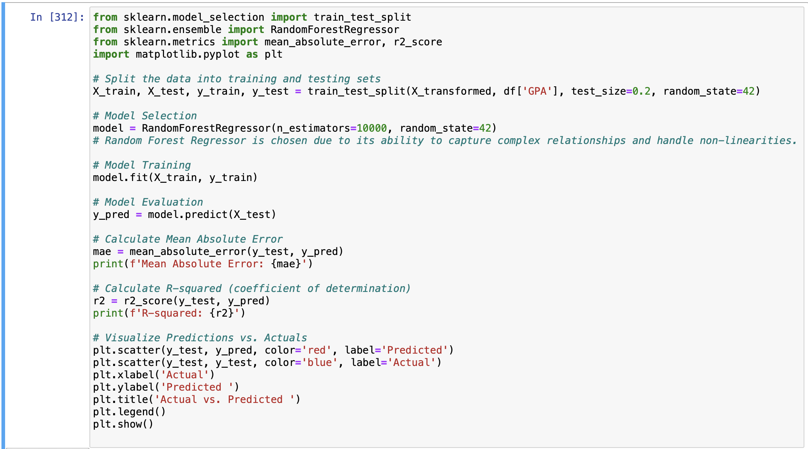
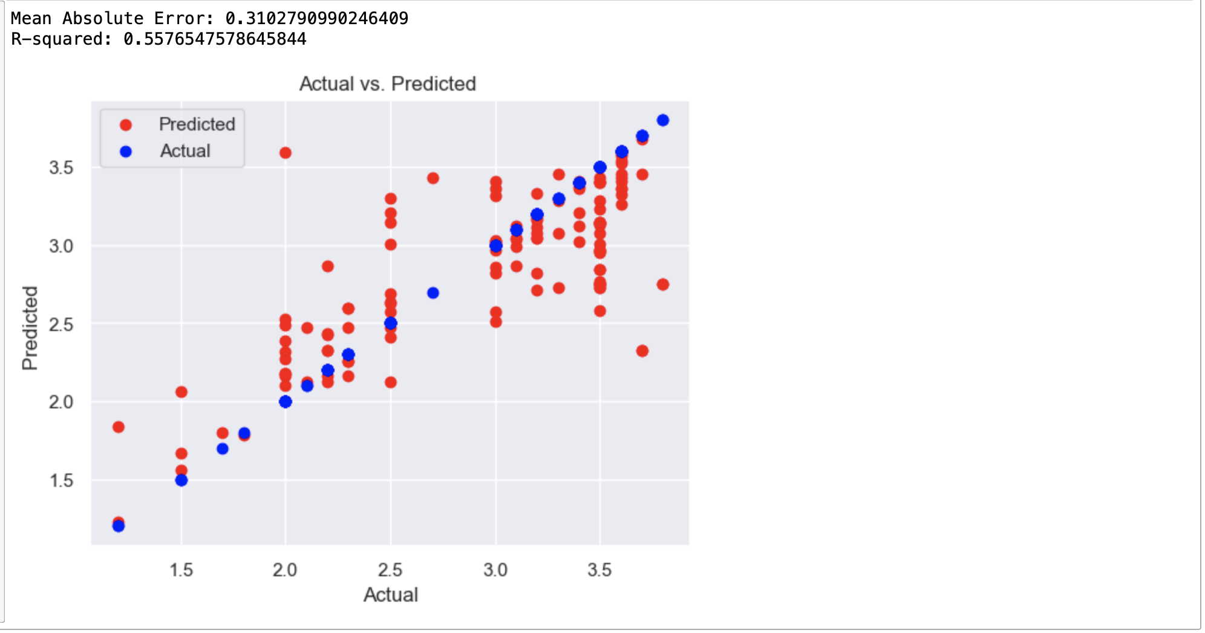
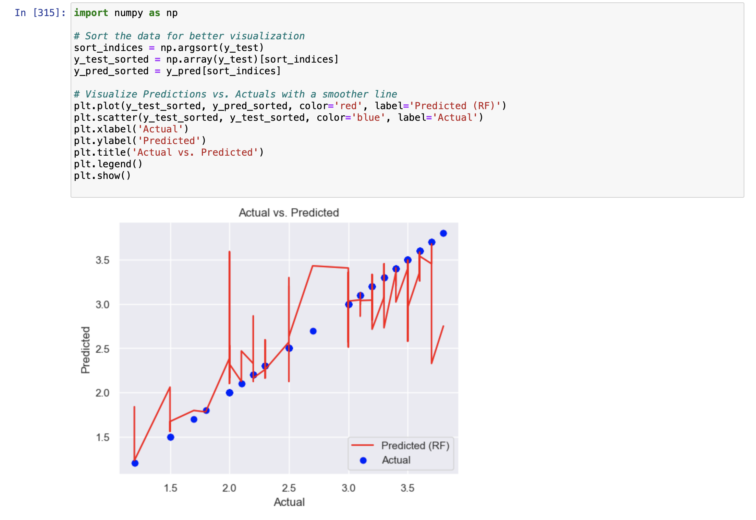
Model exploration
The Random Forest Regressor is one of the suitable choices for predicting academic performance based on social media influence metrics due to its capacity to handle non-linear relationships in diverse data. Its robustness to overfitting, provision of feature importance insights, and use of ensemble learning make it well-suited for capturing the complex dynamics of social media impact on academic outcomes. However, other algorithms such as Gradient Boosting, Support Vector Machines, and Neural Networks could be considered depending on specific dataset characteristics and computational requirements, offering alternative approaches to address the predictive challenges in this context.

Slide 40
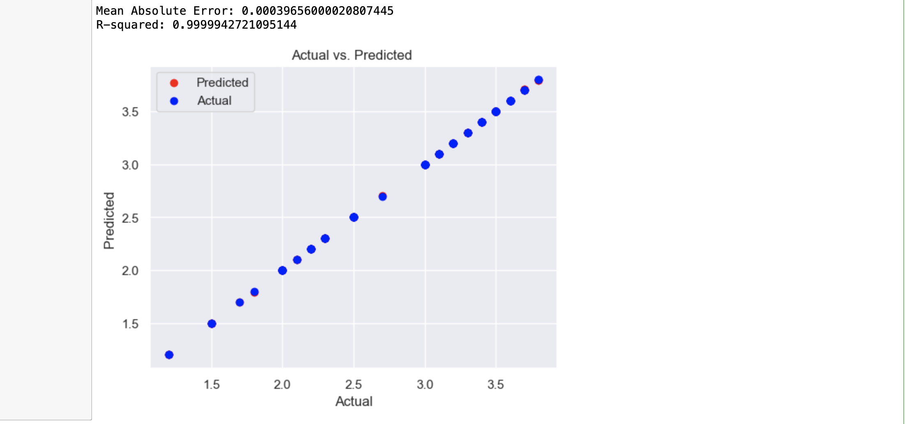
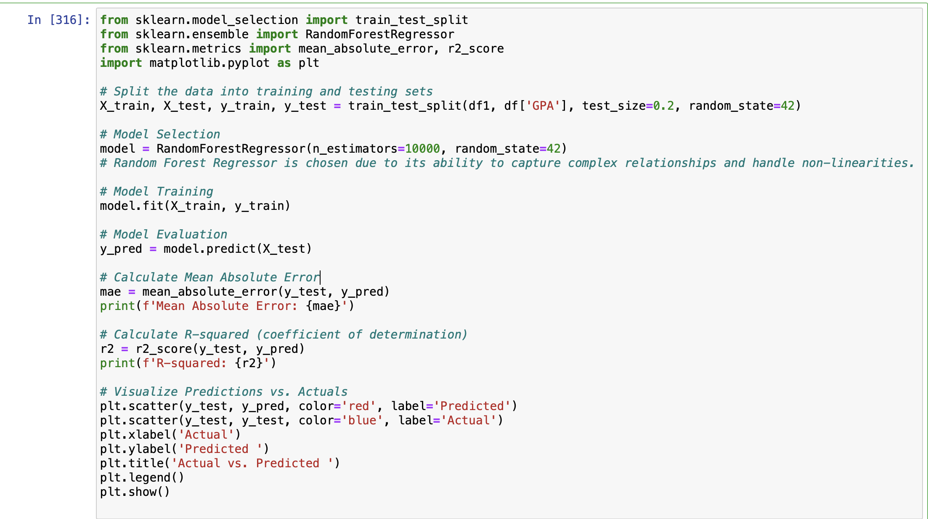
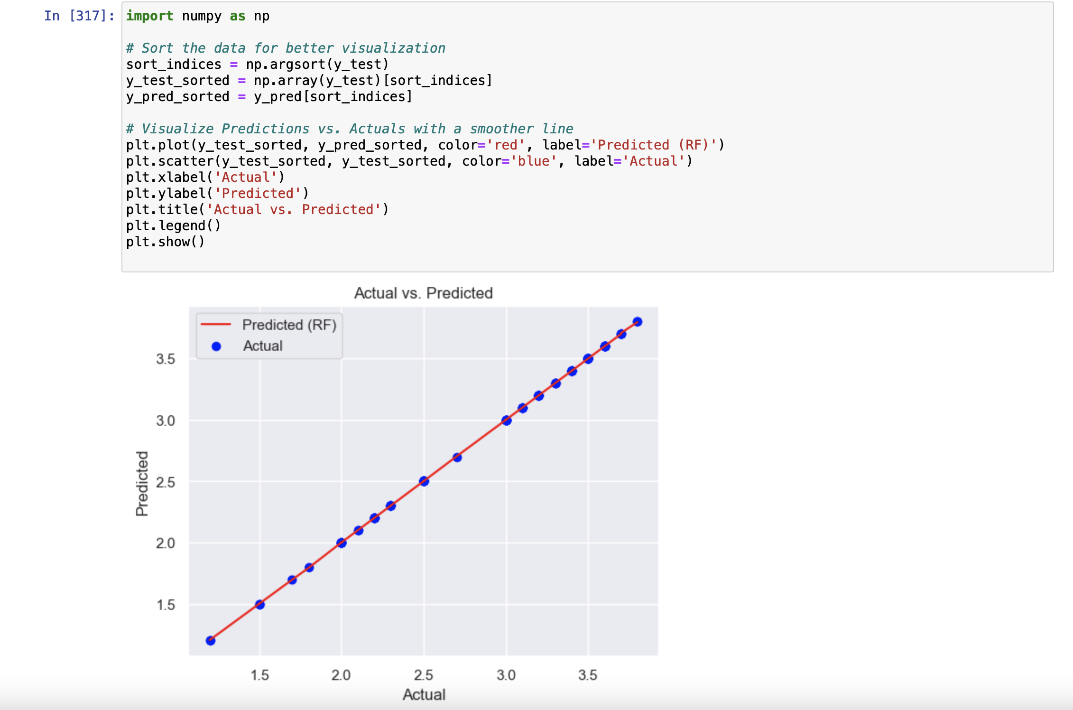

Slide 41
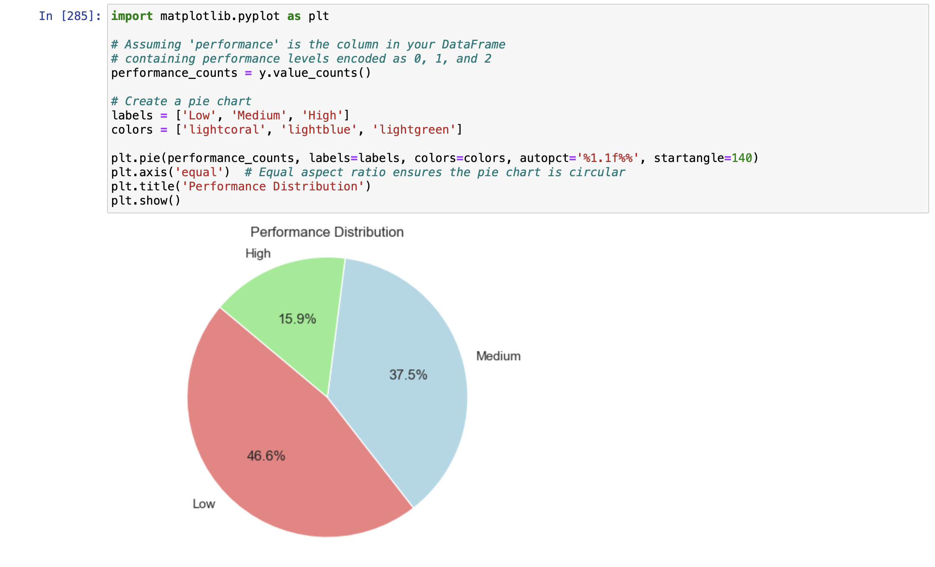
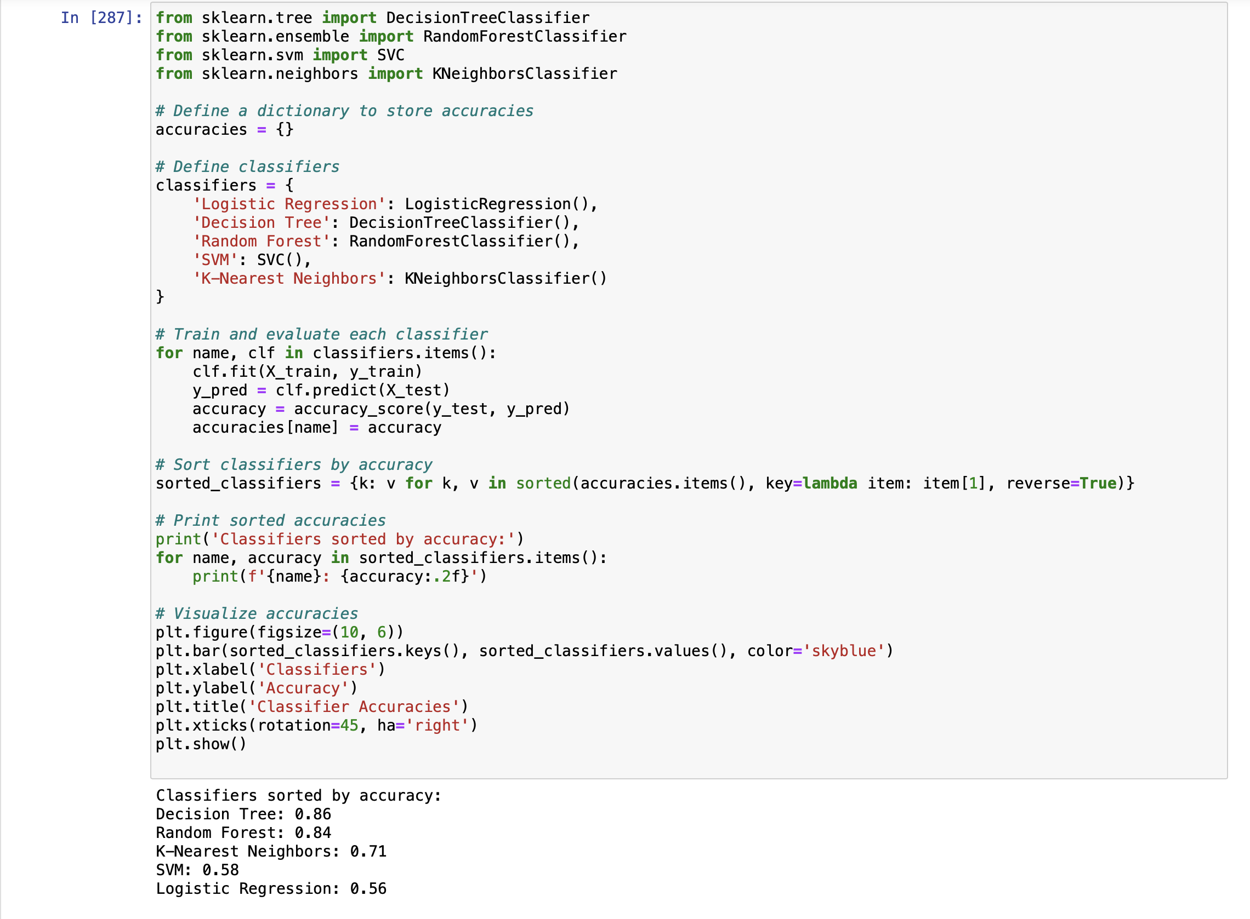
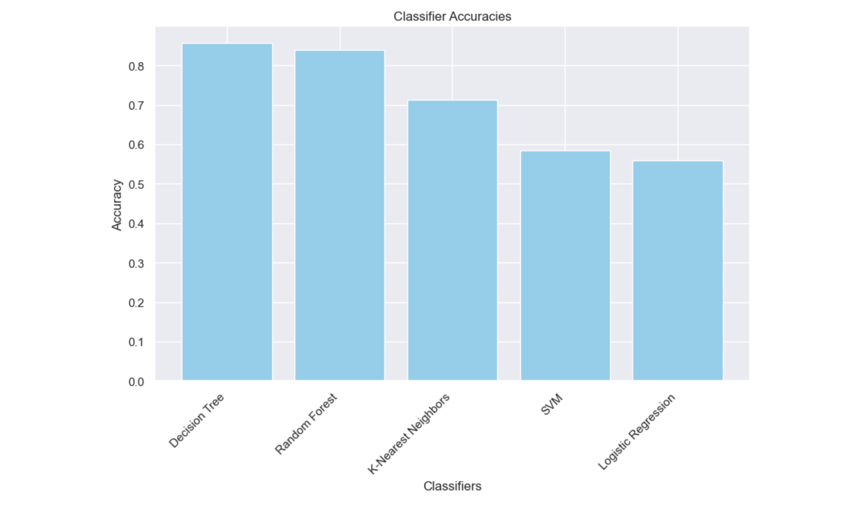

Slide 42
TThank you

